Slide 1
Final Project Presentation
Team Members :
Alifio Rasendriya Rasyid
Muchsin Hisyam
Nicholas Michael Halim
Ricky Anderson

Slide 2

Introduction
In this project, we aim to create a database program for the owner of Little Miss bakery store. This program is created with the goal of helping the owner in keeping track of the bakery order history and revenue based on what they sell.

Slide 3
Features
Customer status become members when the customer already have 5 or more orders history.
Customer who has members status get a specific discount amount.
Revenue graph or bar chart based on weekly, monthly and yearly sales depends on what the owner wants to see.
Generate Invoice details in PDF file.

Slide 4
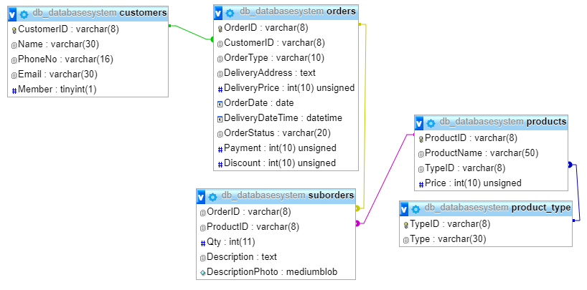
Relation View

Slide 5
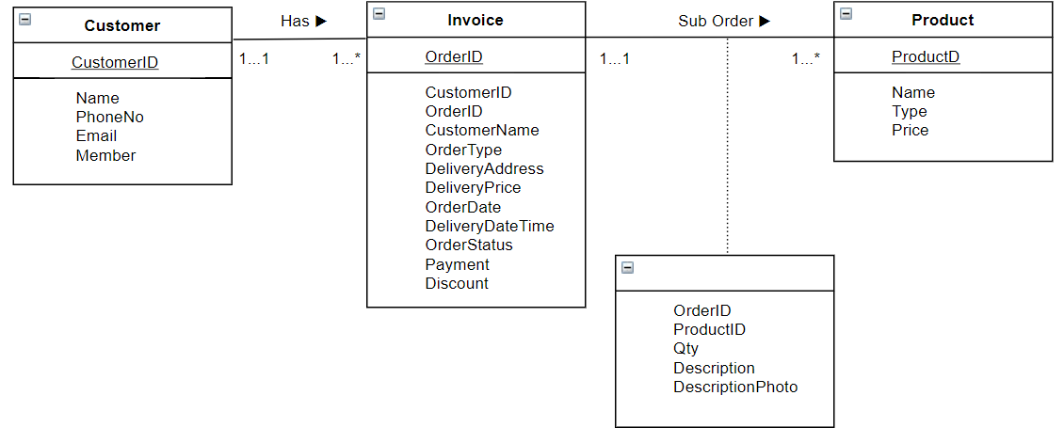
Entity Relationship Diagram

Slide 6
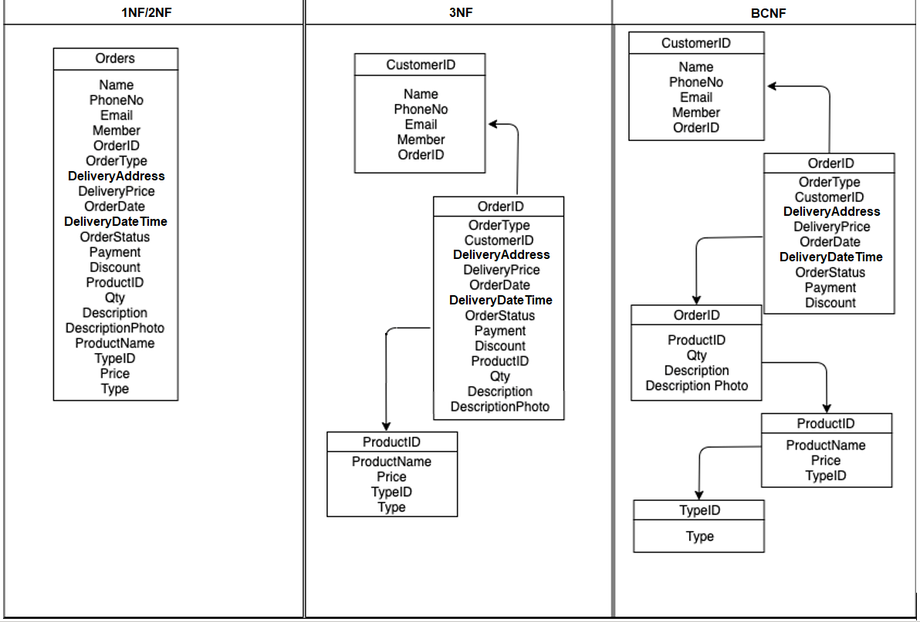
Normalization Process

Slide 7
Database Security
For now, the owner of the business will be the only one operating this application. This is why we only apply security in the form of a local database which is password protected with the help of PhpMyAdmin.
In the future, when the business grows and other employees may be tasked to create new orders, it is possible to apply a login system and disabling the Products and disabling all deletion buttons. This prevents accidental deletion of important rows of data, be it a customer, product, or even an order data. Only the owner’s login information or an admin should have all privileges.

Slide 8
Demo

Slide 9
Thank You!

